Slide 1
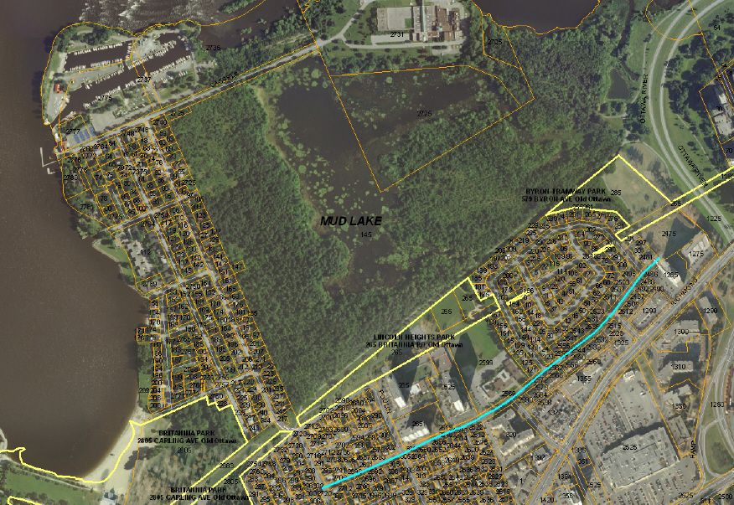
Lincoln Heights Parkway Community Association
Annual General Meeting
October 24, 2021

Slide 2
Draft agenda
Welcome remarks – Annie Boucher
Adoption of agenda
Acceptance of minutes of October 25, 2020 AGM
Community activities & update – Community Association
Britannia Winter Trail update – Parham Momtahan
Treasurer’s Report
MP report – Anita Vandenbeld
Councillor's report – Theresa Kavanagh
Election of officers – Annie Boucher
Other matters
Close of meeting

Slide 3
Past Year’s Activities
Holiday hamper: Provided $1120.00 in gift cards (Metro/Bayshore) for the holidays ($150 from association) – THANK YOU!!
Spring clean up: Approximately 20 people came out
COVID fundraiser: Raised $1,000 for two families in need
Vaccine awareness: Email and social media messaging
Skating rink: Robert Graham is maintaining the rink again, funded by City of Ottawa grant
Ongoing coordination and work with neighbouring community associations on issues – Secondary Plan for area; Britannia Park proposals, etc.
Notes:
First 3 items: Maria
Last 3 items: Annie

Slide 4
Proposed Activities for 2021-22
Membership Drive: Please support your community association! $5 per year per adult in the household; please spread the word to your new neighbours!
Park improvements: Exploring tree planting, community garden, picnic tables, etc. – Tyler Proulx will lead this activity
Winter Follies: Jane Kielly will lead this activity this winter
Summer party and Community Dinner: Hoping to reboot in 2022!
LHPCA newsletter: Bi-monthly newsletter on issues of interest to our community – Sign up on the LHPCA website
Community emergency planning – Community volunteer to reach out with resources and begin to develop a plan for LHP
Notes:
Vesna
Tyler
Jane
Maria
Pierre

Slide 5
Britannia Winter Trail
Maintenance activities
Volunteers
Fundraising
Future plans
https://www.youtube.com/watch?v=bjcHObDmqr8
Notes:
Parham Momtahan

Slide 6
2021 Treasurer’s Report
LHPCA Statement of Operations
For the Year Ending Sept 30, 2021
Carryover from Prior Year |  |  | $2,888.59 | $2,888.59 | $2,990.53
 |  |  | BUDGET | ACTUAL | 2019
Revenue
 | Memberships |  | $220 | $204.55 | $240
 | Donations |  |  | $1,000 | -
 | City of Ottawa Rink Grant |  | $1,813 | $1,813 | $1,813
Total Revenue |  |  | $ 2,033 | $3017.55 | $2,053
Expenses
 | 2021 AGM/Meetings |  | 0 | 0 | 15.25
 | Bank Charges |  | $25 | $39.90 | 58.86
 | Advertising |  | $35 | 0 | 93.59
 | FCA Member Dues |  | $35 | $70
 | Paypal Fees |  | 0 | 0 | 1.35
 | Rink Maintenance Fees |  | $1,713 | $1,713 | 1,713
 | Summer Follies |  | $45 | 0 | -
 | Web Design/ Maintenance |  | $60 | $127.77 | 60
 | Community Library |  | $10 | 0 | 69.79
 | Community Dinner |  | $30 | 0 | -
 | Holiday Food Hamper |  | $150 | $150 | 143.10
 | COVID Fundraiser |  | - | $1,000 | -
 | Britannia Winter Trail donation |  | - | $100 | -
 | Spring Cleanup |  | $15 | $14.68 | -
Total Expenses |  |  | $ 2,178.00 | $3,215.35 | $ 2154.94
Surplus |  |  | - 145 | -197.80 | $ 101.94
Carryover to Next Year |  |  | $ 2,743.59 | $2690.79 | $ 2888.59

Slide 7
2022 Proposed budget
2022 Budget
Carryover from 2021 |  |  | $2,690.79
 |  |  | BUDGET
Revenue
 | Memberships |  | 200
 | Donations & fundraising |  | ?
 | City of Ottawa Rink Grant |  | $1,813
Total Revenue |  |  | $ 2,013 +
Expenses
 | AGM/Meetings |  | 0
 | Bank Charges |  | 50
 | FCA Member Dues |  | 35
 | Paypal Fees |  | 5
 | Advertising |  | 0
 | Rink Maintenance Fees |  | 1,713
 | Summer Follies |  | 50
 | Web Design/ Maintenance |  | 60
 | Britannia Winter Trail donation |  | 100
 | Community Dinner |  | ?
 | Holiday Food Hamper |  | 150
 | Spring Cleanup |  | 15
 | Park (picnic tables, garden, ?) |  | ?
Total Expenses |  |  | $ 2,178
Surplus/Deficit
Carryover to 2021

Slide 8
Member of Parliament
Anita Vandenbeld

Slide 9
Bay Ward Councillor
Theresa Kavanagh

Slide 10
LHPCA Board Elections
Call for Nominees

Slide 11
Executive Committee Structure & Members Continuing for 2021-22
President Open
Vice President Open
Secretary Open
Treasurer Open
Director at Large (max 3) Open
Open
Open
Membership Coordinator Vesna Lukic
Past President Annie Boucher
Notes:
We have a real opportunity for renewal. We want to thank the dedicated members of hte committee who have given much of their time in the past several years, including Maria Rogers, We have many new members in our community who want to make a difference and now is a great time for renewal!

Slide 12
Candidates for 2021-22
Positions Nominees
President (1 year term) Tyler Proulx
Vice-President Sarah Nikkel
Secretary (1 year term) Tanya Middlebro'
Treasurer Pierre Chevrier
Directors at Large JR Fortin
Jane Kielly
Patti Murphy

Slide 13
What can the Community Association do for you?

Slide 14
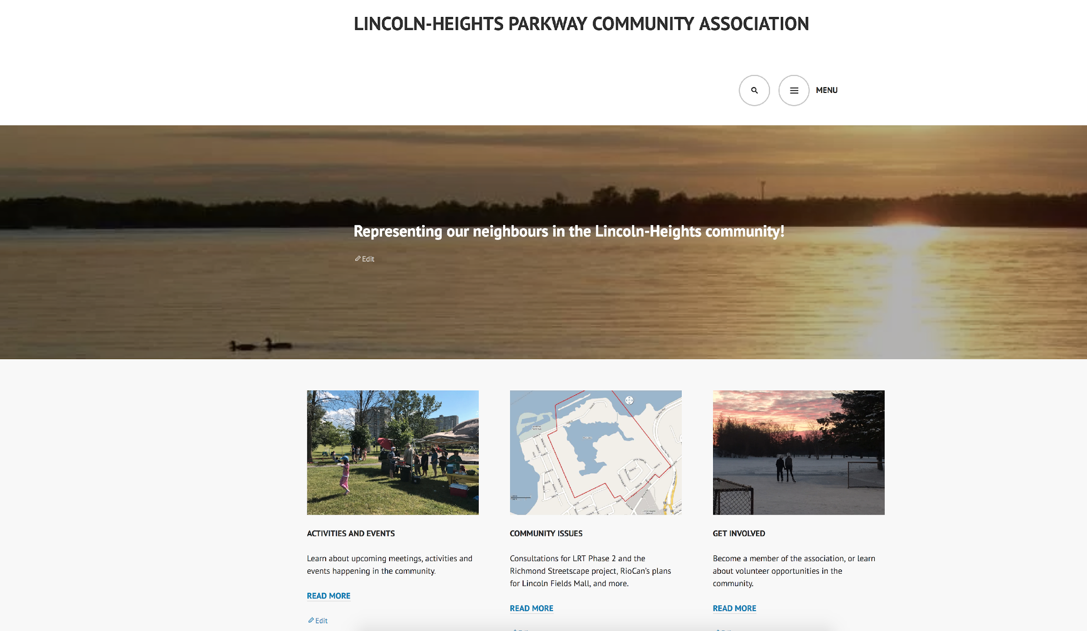
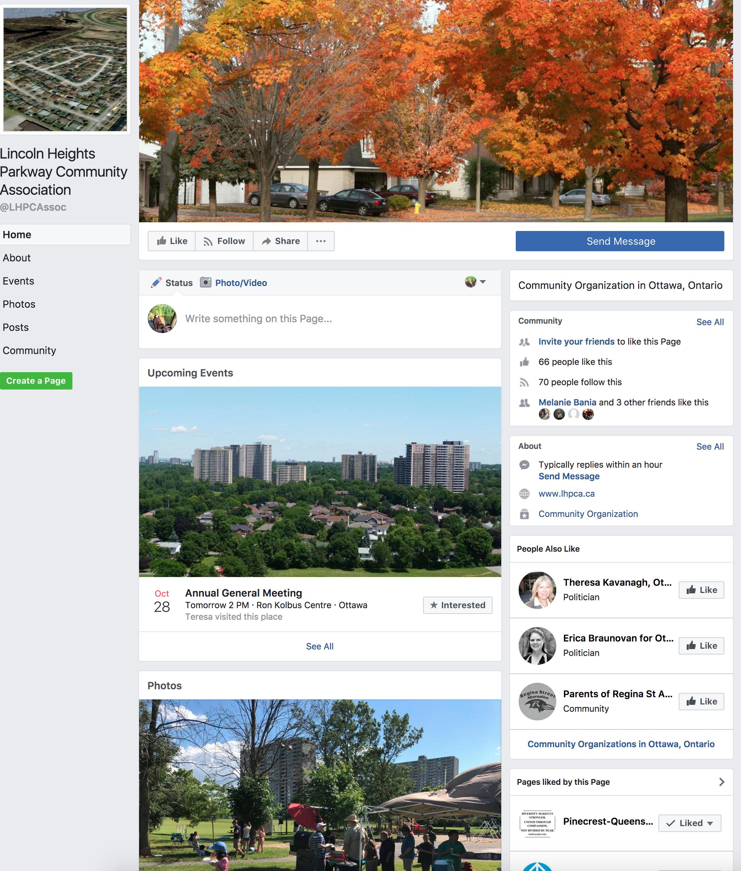

Contacts
To volunteer or enquire:
Contact Executive Committee at: lhpca.info@gmail.com
LHPCA website:
www.lhpca.ca
On Facebook
www.facebook.com/LHPCAssoc

